Slide 1



Project 1: AirBnB Investment
Washington, D.c.

Slide 2

Proposed questions (Based on chosen prompt)
- Should you invest in an Airbnb property in Washington, D.C.?
- If so, which neighborhood is promising to invest in?

Slide 3
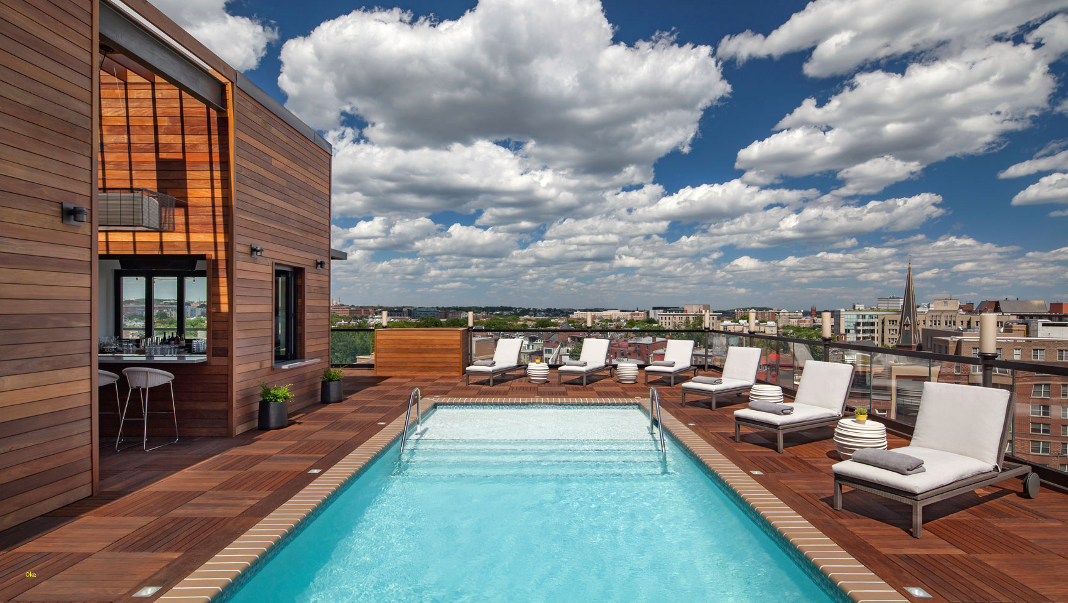
Outlines
Data Cleaning Methods
Data Analysis Findings
Recommendations

Slide 4


Data Cleaning methods
Remove The unnecessary data
calculations
- Remove The columns from the data set with texts and URLs
- Remove the rows where the state is other than Virginia and Maryland
- Highlight the columns that may be needed in our analysis
- Fill out the missing fields of (beds, bedrooms, bathrooms)with values based on the average of the (bathrooms and beds for each bedroom, PivotTable was much useful
- Create column (stays_estimate) with the value of number of reviews * 2
- Create column (estimated_2_guests_price) Using nested IF to define: “guest_included = 1” AND “accommodates = 1,” then the listing is only for one person or If “guest_included = 1” AND “accommodates > 1” then Price + extra_people
- Create column (estimated revenue per booking) minimum_nights * estimated_2_guests_price
- Create column (estimated total revenue) estimated revenue per booking * stays_estimate

Slide 5
What types of property is there in Washington?
Property Type | Entire home/apt | Private room | Shared room
Apartment | 297 | 38 | 3
Bed & Breakfast | 8 | 7
Cabin | 1
Condominium | 6
House | 179 | 110
Loft | 6
Townhouse | 17
Grand Total | 514 | 155 | 3

Slide 6
Top 10 successful hosts based on their total revenue and being a “Superhost”
Successful host name | Estimated total revenue
Jay And Mau | $110,320
Christine + Mike | $139,200
James | $139,596
Drury | $160,050
Joel | $163,678
Serge | $196,716
Ken | $206,280
Ethan | $236,970
Matt And Jean | $329,850
Gohar | $504,630

Slide 7
What is the best neighborhood to invest in?
Based on most successful hosts selection:
The red dot above is: Capitol Hill!

Slide 8
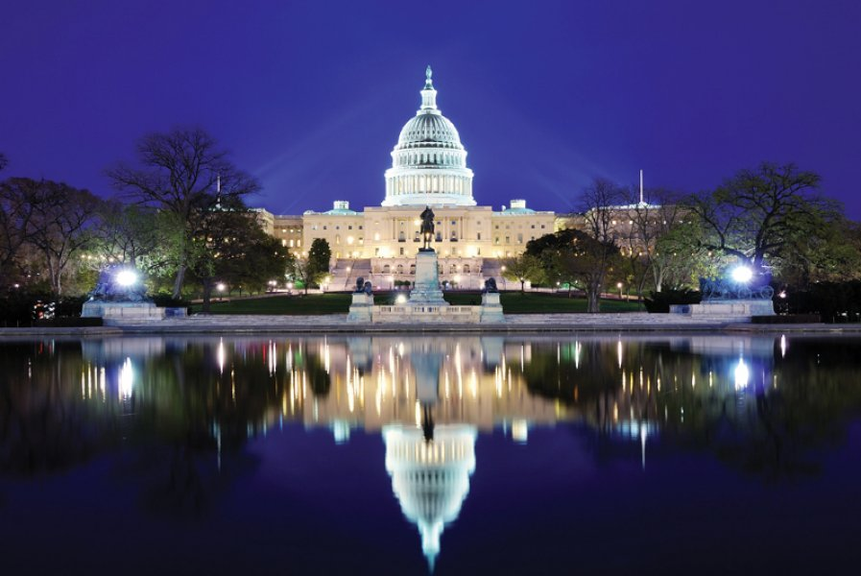
Recommendation
Based on our analysis, it will become be a good investment in Washington, D.C. when use choose:
An Apartment
Type Entire home/apartment
And located in Capitol Hill (LOOK AT THE VIEW!)..

Slide 9

Thank you and special thanks to misk Academy who gave us this beautiful gift!
Saad alshalhoub & wejdan alqahtani
http://www.Misk.org.sa

